Slide 1

Operating Systems Courtesy of BGU-CSE and Dr. Itamar Cohen
Tutorial 9 – Memory I: page tables
Ben-Gurion University of the Negev Communication Systems Engineering Department

Slide 2


Motivation & the memory (usage) explosion

Slide 3

Solution 1: per-process base & limit
This sol’ requires:
☹ Per-instruction address calculation
☹ Knowing in advance each process’s memory demands
☹ Having all processes in the memory simultaneously
Notes:
Base & Limit problems:
Need to re-calculate locations in mem (eg, jmp), so as to switch from absolute to relative addressing.
Need to compare value, to verify no seg. fault
** Main prob’: cannot have all processes in mem.
Cannot know in advance how much mem. the process requires.

Slide 4

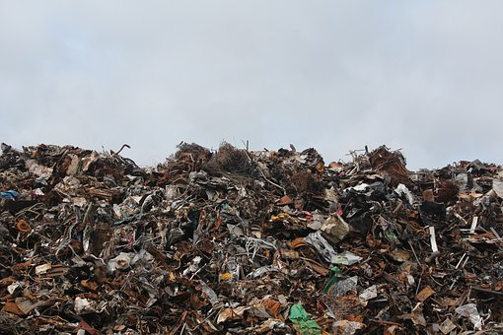
Solution 2: swapping
Notes:
Swapping means we bring the entire memory space of a process to the memory, use it, and possibly put it back to our store (e.g. large enough disk).
Problems:
Cannot know in advance how much mem. the process requires.
Swap time is proportional to the amount of swapped memory – a heavy operation for process with large use of memory.
Garbage collection: During the time, swapping creates “holes” of too small amounts of available memory in memory map.

Slide 5


Solution 3: Paging and Virtual Memory
Page
table
Physical mem
0
X (in disc)
page 0
…
1
X (in disc)
page 1
…
2
0
page 2
…
3
3
page 3
…
4
X (in disc)
5
1
6
2
7
X (in disc)
Notes:
Virtual Memory:
What happens when a process’s memory requirements are too large to fit into the physical memory?
Only part of the program is held in the memory while the rest stays in our store.
This means we can support an address space which is independent of physical memory (on a 32 bit machine, there are 2³² addresses in virtual address space).
What does a page table entry include?
How do we use page & offset?

Slide 6
Outline
Virtual memory: motivation
Page tables: introduction & motivation
Page tables: implementation

Slide 7
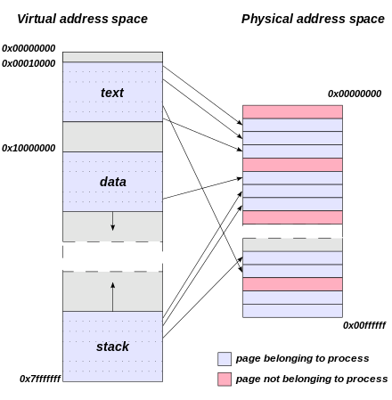
Page tables
Fig. taken from Wikipedia

Slide 8
Question 1: page table’s size
64-bit computer
Size of physical memory: 4GB
Size of page: 4KB
How many pages are possible?
Each entry in the page table contains
Location of the required page frame in the physical memory (if presents)
6-bits ctrl info (Valid, dirty, referenced etc).
What’s the size of the page table?
Notes:
See accessory file: P_Tables_lec_from_nrg.cs.ucl.ac.uk_by_mjh.pdf
# of Page table entries: 2^(64 – 12) = 2^52
# of pages in the memory: 4GB / 4KB = 1M → addr. Of page in mem. Reqires 20bits.
Total size: (2^52)*26
Assuming that only 1TB can code valid addresses:
We’ve “only” 2^(40-12) optional pages.
Still have 26*2^(40-12) = 26*2^28 =~ 32*2^28 = 2^33 = 8Gbit = 1GB.
Same order of magnitude as the main mem itself!

Slide 9
PTE
Page Table Entries (PTE) contain (per page):
Page frame number (physical address)
Present/absent (valid )bit
Dirty (modified) bit
Referenced (accessed) bit
Protection
Caching disable/enable
page frame number
Notes:
Page frame #.
Present / Absent (Valid) bit – is page part of process address space
Modified (dirty) bit required for knowing whether to write back to disk upon eviction
Referenced bit required for help selecting which page to evict
Protection bit/s: e.g., read/write/execute
Caching disabled, when the page is mapped to device memory, e.g. when the OS is waiting for a device to respond, it wants to read its current response, not a cached copy of a previous response.
Optional: insertion / reference time (for LRU)

Slide 10
Outline
Virtual memory: motivation
Page tables: introduction & motivation
Page tables: implementation issues
Inverted page tables
TLB
Multi-stages tables
Page size

Slide 11
page table: implementation challenges
Memory space
Latency
Power
Scalability

Slide 12
Inverted Page Table
Observation: most PTEs are invalid
441
What is the size of an inverted page table, assuming the same parameters as in the question 1?
Note: the inverted page table holds only the physical pages
Page table miss → page fault
How to implement it directly?
Is there a more scalable solution?
Notes:
We’ve 4GB / 4KB = 2^20 physical pages.
Each page should have a 52-bit entry for its disc location + 6 ctrl bits.
Total: 58*2^20 << 26*2^52
Imp’ directly: associative memory.
A more scalable solution: hash tables

Slide 13
Outline
Virtual memory: motivation
Page tables: introduction & motivation
Page tables: implementation issues
Inverted page tables
TLB
Multi-stages tables
Page size

Slide 14
Translation Lookaside Buffer
Associative memory
Like a fully-associative cache
Or a Content-Addressable Memory
High area and power consumption
Virt | Phy
11
20
7
21
13
X
22
13
5
9
66
8
3
11
18
62

Slide 15
Outline
Virtual memory: motivation
Page tables: introduction & motivation
Page tables: implementation issues
Inverted page tables
TLB
Multi-stages tables
Page size

Slide 16
Question 2, part1
Consider a 32-b system
Each process has its own page table
Per-process page table size: 1 page
Page Table Entry size: 1 Word (32-b)
A) What should be the page size?
B) How much data should be copied from the memory for initializing a process with 1KB mem?
C) What’s the maximal memory a process may consume before a page fault occurs?
Notes:
A) Denote the page’s size by x Bytes. The number of entries in x is x/4, because each entry takes 4 B.
We would like this single page to map all possible pages in the system.
The number of pages in the system is 2^32 /x.
Therefore we have 2^32/x = x/4 → x = 2^17.
B) A process of 1KB requires 1 data page + 1 page table page → 2x = 2^18B.
C) Assuming that upon starting the process only its single page is copied to the memory (no pre-fetching of additional pages), the process may consume only x=2^17 B. Above it, a page fault occurs.

Slide 17
Question 2, parts 2-4
Part 2 It’s now given that the system uses a 2L page table. Repeat part 1
Part 3 Repeat part 1 for a 64-b 1L page table.
Part 4 Repeat part 1 for a 64-b 4L page table.

Slide 18
Outline
Virtual memory: motivation
Page tables: introduction & motivation
Page tables: implementation issues
Inverted page tables
TLB
Multi-stages tables
Page size

Slide 19
Page table size
Modern OSs use (sometimes) larger pages (4MB).
What are the pros. and cons. of larger pages?
What about using multiple-sized pages?
Notes:
Disc search time is not linear (even if SSD).
Larger page → Higher prob’ of dirty.

